Slide 1
Intro to Kotlin
BCS421 - Mobile Development
By Dr. Moaath Alrajab
Computing Division
School of Engineering Tech.

Slide 2
Introduction to Kotlin
The next big thing in the Java world

Slide 3
What is Kotlin?
A (fairly) new statically-typed language from JetBrains (creators of IntelliJ Idea, ReSharper, PyCharm and other IDEs and IDE extensions)
Tries to fix many of Java’s shortcomings
Compiles to JVM bytecode, JavaScript (!) and Kotlin native (no VM)
Created with focus on Java interoperability – Kotlin and Java classes can be used together in a project (but compilation is much faster than Scala’s)

Slide 4
What is Kotlin?
Works seamlessly with IntelliJ Idea, just a bit less seamlessly with Eclipse
The Java interoperability is real – even complex applications, relying on annotation processing
It’s gaining more and more traction and is being adopted increasingly often, especially in the recent year
Has very good suport from JetBrains, an established company, who use Kotlin to develop their own products

Slide 5

Google and Android
At Google I/O 2017, Google announces that Kotlin would receive first-class suport
for Android development

Slide 6
What does Kotlin feature?
Null safety (drastically limiting the number of NPEs);
If, try-catch, when expressions;
Extension functions;
Var and val keywords;
Inline functions;
Named function parameters;
Multi-value return functions;
Semi-colons are optional

Slide 7
More things…
Functional programming constructs (like higher order functions)
Smart casting
Async/await
Data classes
Properties (C#- like)
No checked exceptions
Operator overloading
… this is just scratching the surface

Slide 8
Let’s dive deeper and explore Kotlin!

Slide 9
Typical Kotlin Program
Developers commonly use an Integrated Development Environment (IDE) to write Kotlin programs. Android Studio is the most popular IDE for writing Android apps with Kotlin.
A developer creates and runs a typical Kotlin program in the following way:
A developer uses an IDE to type Kotlin code into a source file with a .kt file extension.
The IDE compiles Kotlin source files into bytecode, which are binary instructions stored in a file with a .class file extension.
The program runs on a Java Virtual Machine (JVM), software that executes bytecode.
A Kotlin program must have a function called main.

Slide 10
Comments and semicolons
A comment is any text in a program intended for humans and ignored by the compiler. Kotlin uses the // operator to produce a single-line comment and /* */ operators to produce multi-line comments.
Kotlin allows statements to be terminated with a semicolon, but terminating semicolons are not necessary. Only when two statements reside on the same line must a semicolon separate the two statements.
Good practice is to avoid placing two statements on the same line.

Slide 11
Variables and data types
Kotlin uses two different keywords for declaring two different types of variables:
A regular variable is declared with the var keyword. Ex:
var score: Int declares a regular variable named score with the Int (integer) data type.
A read-only variable is declared with the val keyword. Ex:
val maxPages: Int = 10 declares a read-only variable maxPages that is always 10.

Slide 12
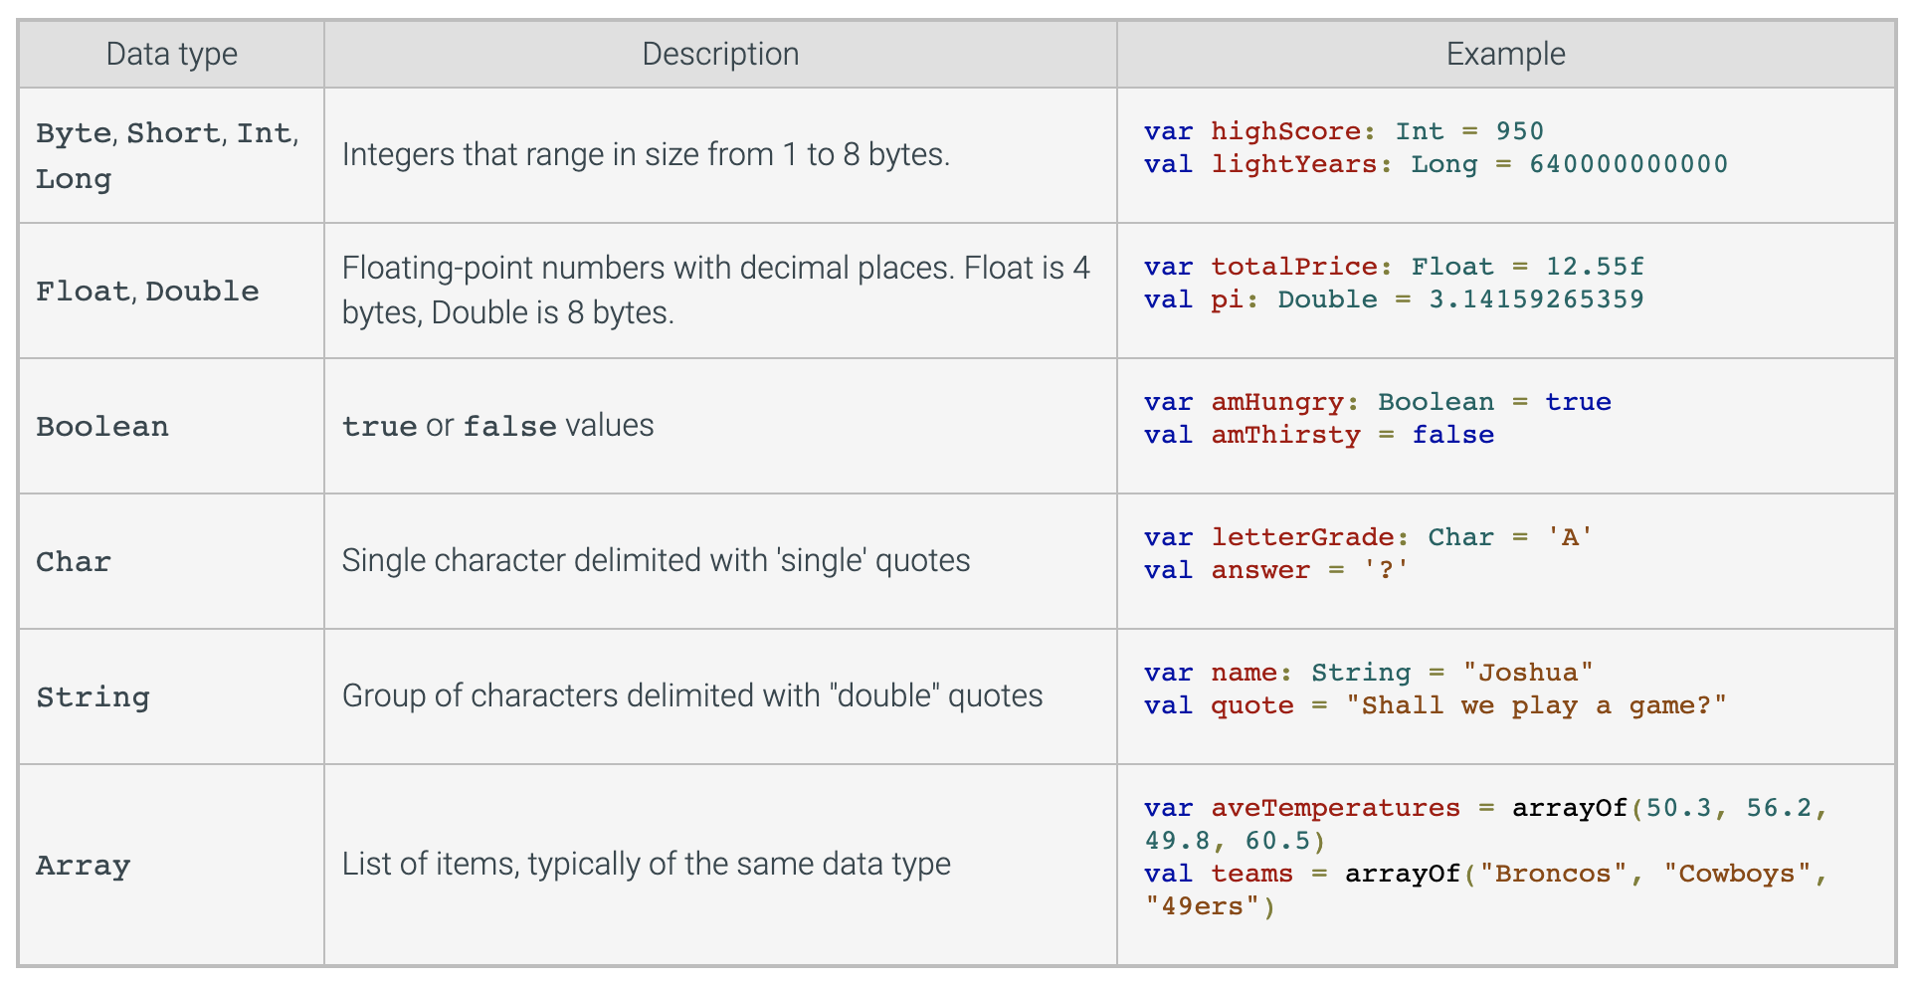
Variables and data types

Slide 13
Naming variables
A name created for an item like a variable or function is called an identifier. Kotlin imposes the following rules for identifiers:
An identifier can be any combination of letters, digits, or underscores.
An identifier may not start with a digit.
An identifier may not be a reserved word like fun, var, or if.
An identifier is case sensitive.

Slide 14
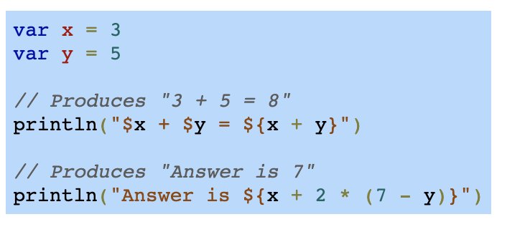
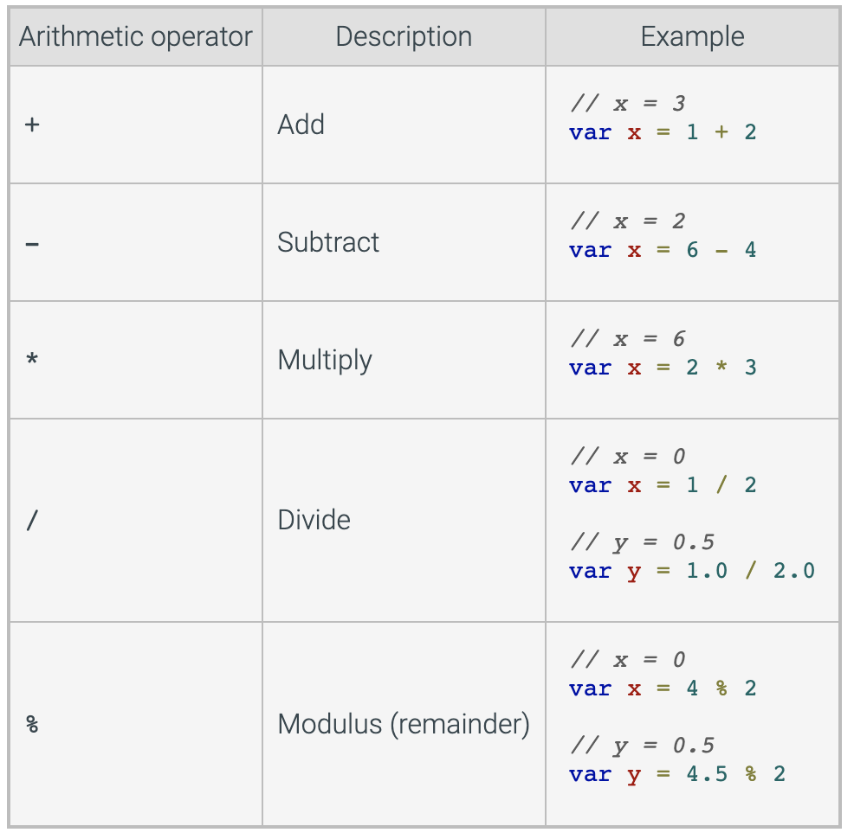
Arithmetic in string template

Slide 15
Conditionals
An if statement executes a block of statements if a condition is true. An if-else statement executes a block of statements if the statement's condition is true and a different block of statements if the condition is false. Braces {} surround the statement blocks.
If (condition){
// statements if true
} else{
// statements if false
}

Slide 16
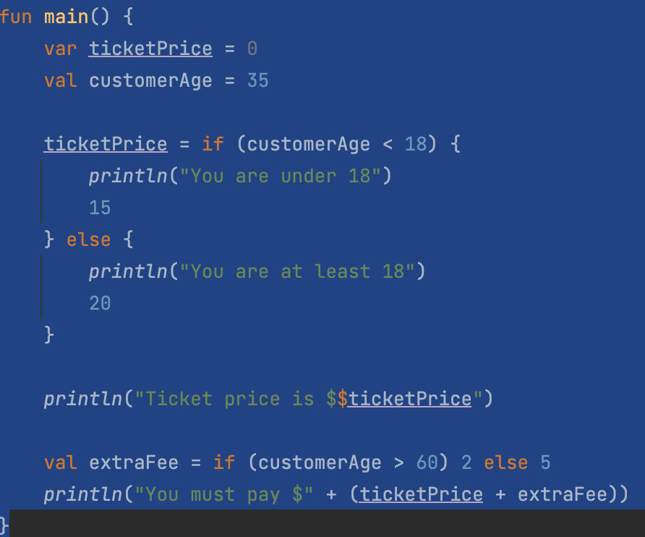
Example

Slide 17
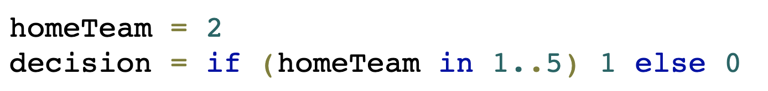
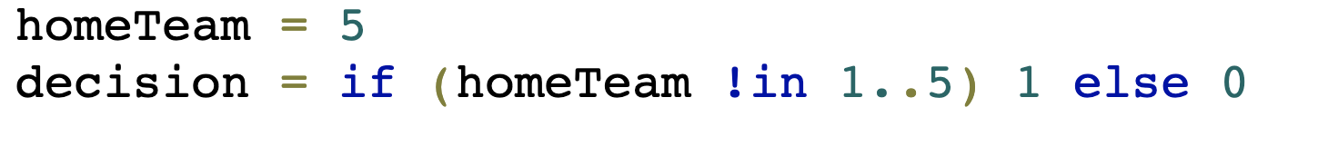
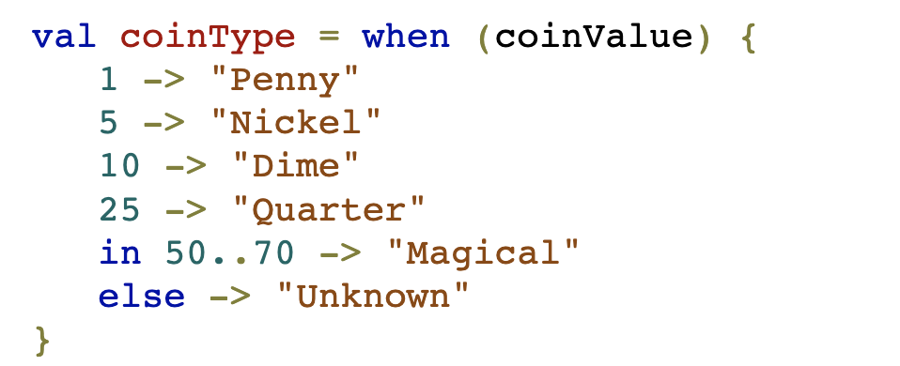
Conditions – in and when
Assume coinValue is 25

Slide 18
Conditions – in and when
Decision is 1
Decision is 0
When coinValue is 25 then
coinType is “Quarter”

Slide 19
Kotlin Hard vs Soft keywords
Hard keywords are always interpreted as language keywords and cannot be used as identifiers while soft keywords (including modifiers) can be used as identifiers (depends on the context).
Hard Keywords | Soft Keywords
as is used for type casts. specifies an alias for an import as? is used for safe type casts. break terminates the execution of a loop. fun declares a function. is checks that a value has a certain type. is used in when expressions for the same purpose. | by delegates the implementation of an interface to another object. delegates the implementation of the accessors for a property to another object. delegate is used as an annotation use-site target. get/set declares the getter and setter of a property. is used as an annotation use-site target. inline tells the compiler to inline a function and the lambdas passed to it at the call site.
https://kotlinlang.org/docs/keyword-reference.html#hard-keywords

Slide 20
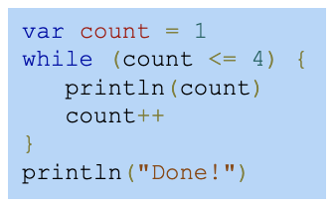
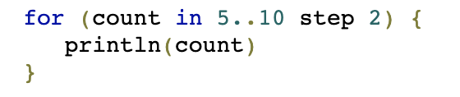
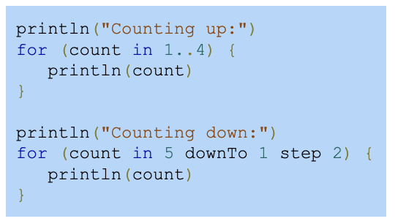
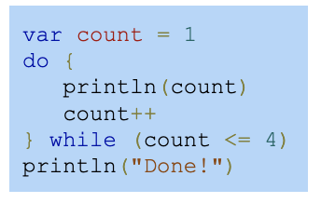
Loops
while loop
do-while loop
for loop

Slide 21
Conclusion
Kotlin is low-cost: can be developed in the same IDE, in the same project as Java code
Did I mention first-class Spring support?
It’s on track to become one of the leading JVM languages
It’s best suited to work with IntelliJ idea; it can be adapter to Eclipse, albeit with some shortcomings
It’s cool; allows bragging to friends about using the latest technologies

Slide 22
End of Intro To Kotlin
Thank you
Q/A

